Slide 1

University of Tahri Mohamed Bechar
Faculty of Exact Sciences
Department of Computer Science
Advanced Operating System
Dr. Soumia BENKRAMA
benkrama.soumia@univ-bechar.dz

Slide 2
Course Description
Semester: 7
Title of the Teaching Unit: UEF71
Credits: 5
Coefficient: 3
VHHs (Credit Hours): Lectures (3h00)
Practical sessions (1h30)

Slide 3

Objectives
Introduce the issue of parallelism in operating systems, study the implementation of cooperation through synchronization and communication tools and the associated problems.

Slide 4
Program Content:
Chapter 1: Notions of parallelism, cooperation and competition.
a. Sequential processes.
b. Concept of task.
c. Task systems and precedence graph.
d. Task system language.
e. Task system state.
f. Determinism and maximal parallelism.
g. Cooperation and competition.
h. Thread concept.
Chapter 2: Synchronization between processes.
a. Mutual exclusion problem.
b. Implementation of mutual exclusion (lock, alternation, Peterson, TSL, sleep primitives, and wakeup).
c. Synchronization problem.
d. Implementing synchronization (event counters, semaphores, monitors)

Slide 5
Chapter 3: INTER-PROCESS COMMUNICATION
a. Problematic.
b. Exchange of messages.
c. Mail boxes.
d. Communication tubes under Unix.
e. Signals.
f. Sharing variables (variables, files, data segments).
Chapter 4: DEADLOCK
a. Introduction.
b. Deadlock.
c. Necessary conditions for deadlock.
d. Solutions to the deadlock problem.
e. Detection and recovery.
f. Deadlocks avoidance.
g. Prevention of deadlocks: PERSONAL WORK.

Slide 6
Chapter 1:
Notions of parallelism, cooperation and competition.

Slide 7



Basic concepts

Slide 8
Process
A process is a program in execution. The code and data are loaded into M.C, and the instructions are executed sequentially by the processor.
Usually, a process has a single controlling thread, i.e. a single set of machine instructions executing at any given time. It can also have several execution flows (multi-threaded).

Slide 9
Thread
Thread (lightweight process) is a sequential subset of instructions within a process.
Several threads can run at the same time (concurrently on a uniprocessor machine, in parallel on a multiprocessor machine)
such as the Word text editor having two threads: one which controls the input, and another thread that performs periodic automatic saving.

Slide 10
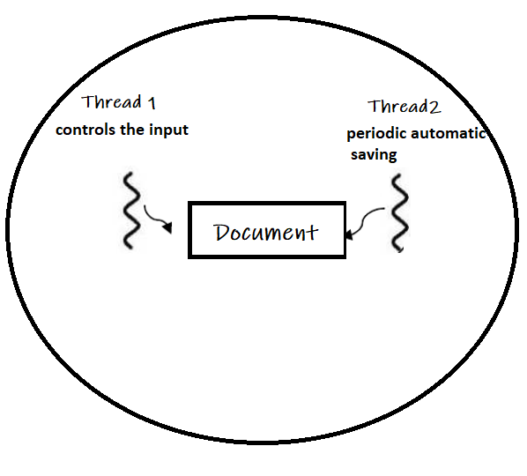

Slide 11
The advantages of the thread approach
In many applications, several tasks are performed simultaneously, which allows pseudo-parallelism (overlap between tasks), offering more execution time savings.
Threads share resources like memory space.
Threads are faster to create and destroy (lightweight processes).
Threads are useful in multiprocessor systems (parallelism)

Slide 12
The different states of a process
The state of a process determines its situation in the system, concerning its resources.
During its execution, a process (or thread) can be in one of these five states:
New (Create): The process is created by the system
Ready: New -> Ready to run. After the creation of a process, the process enters the ready state i.e. the process is loaded into the main memory. The process here is ready to run and is waiting to get the CPU time for its execution.
Active: The process is in execution
Blocked: The process is waiting for a physical or logical resource other than the processor to execute (end of I/O, etc.)
terminated: The process finishes its running and waits to be unloaded from the C.M

Slide 13
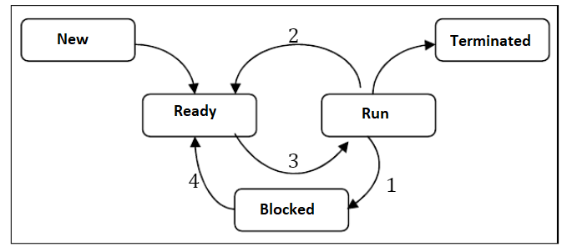
1. Process is blocked due to I/O
2. The CPU is running another process
3. The CPU takes over the process
4. I/O is available

Slide 14


Slide 15
Task Systems
A task system is an abstract model of computations to be executed. It consists of multiple tasks that can be executed sequentially or in parallel.
Each task has a state, an execution duration, and possible dependencies on other tasks.

Slide 16

Tasks

Slide 17





Notion of tasks
A task is an elementary processing entity that has logical coherence and performs a specific part of a program.
A process (P) can be composed of a sequence of tasks executed in a specific order:
means that P consists of the sequential execution of tasks T1, T2, ..., Tn.

Slide 18
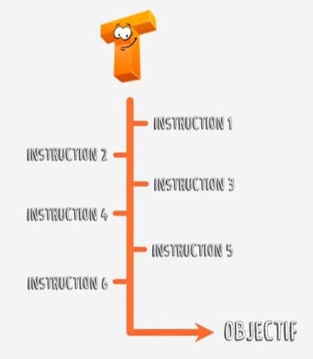
Thread of execution of a set of instructions
Basic processing unit with logical coherence

Slide 19


Task system
set of tasks: : A group of independent or dependent tasks that need to be completed within a system.
Precedence Relation: A constraint that defines the execution order between tasks, meaning that a task T2 cannot start before T1 is completed if T1 → T2 (T1 precedes T2).

Slide 20


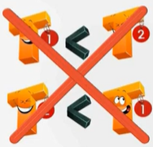




Precedence Relation
Irreflexive
Asymmetric
Transitive

Slide 21

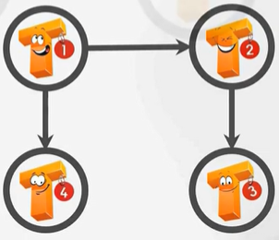
Precedence graph
Task system
Precedence graph
represented by

Slide 22



Precedence graph
Predecessor of
Successor of
immediate successor of

Slide 23
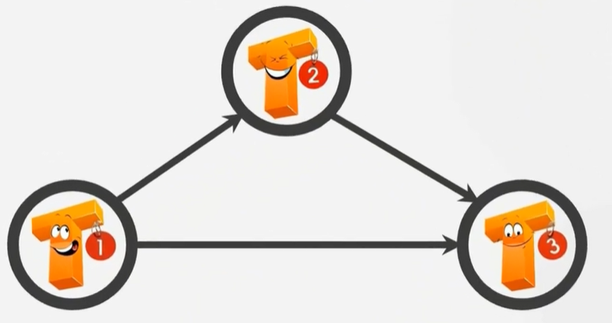
Precedence graph

Slide 24
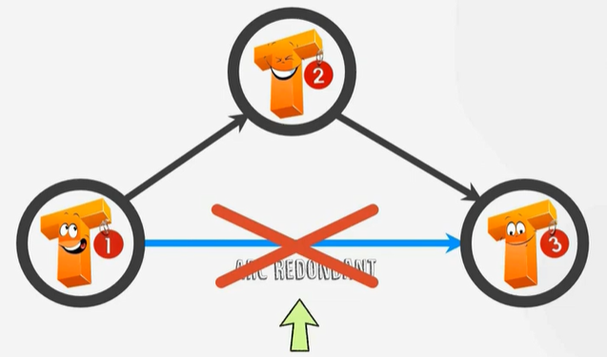
Precedence graph
Elimination of redundancy

Slide 25
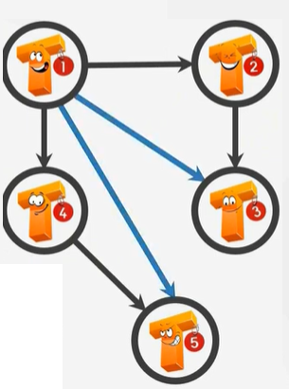
Precedence graph
Identification of redundant arcs

Slide 26
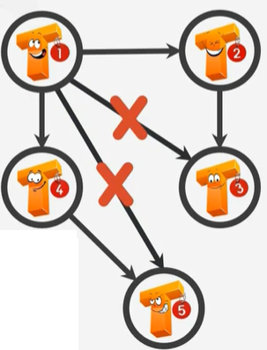
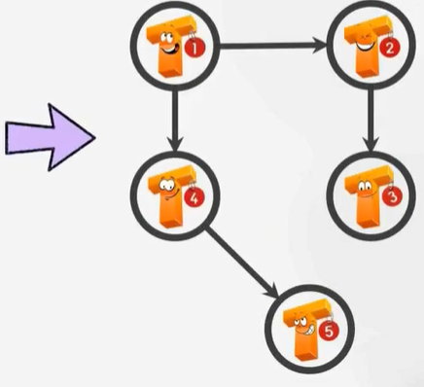
Precedence graph
Elimination of redundancy

Slide 27
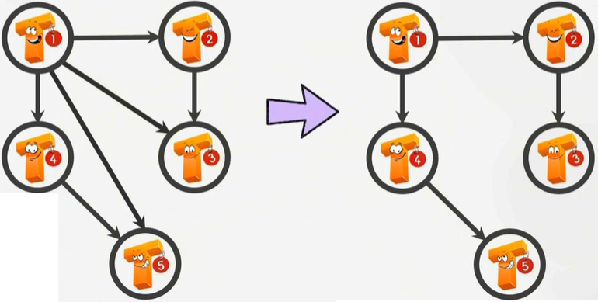
Precedence graph
Graph
Precedence graph

Slide 28

Types of Task Systems (1)
Sequential System: Only one task is executed at a time.
Example: A program that reads a file line by line and processes each line before moving to the next.
Illustration:

Slide 29

Types of Task Systems (2)
Parallel System: Multiple tasks can run simultaneously, leveraging hardware resources such as multi-core processors.
Illustration:

Slide 30
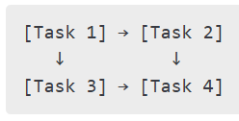
Concurrent System: Multiple tasks are in progress, but not necessarily executing at the same time. Scheduling and task management influence their execution.
Example: A web server handling multiple client requests alternately.
Illustration:
Types of Task Systems (3)

Slide 31
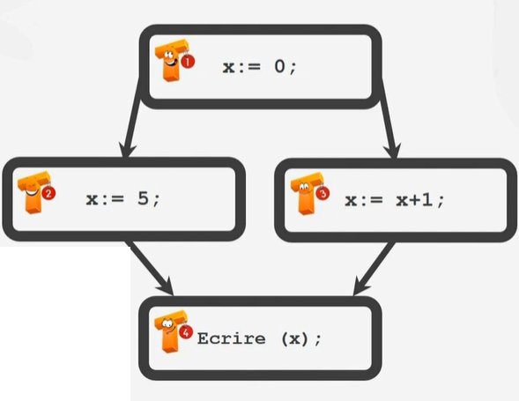

Task System

Slide 32
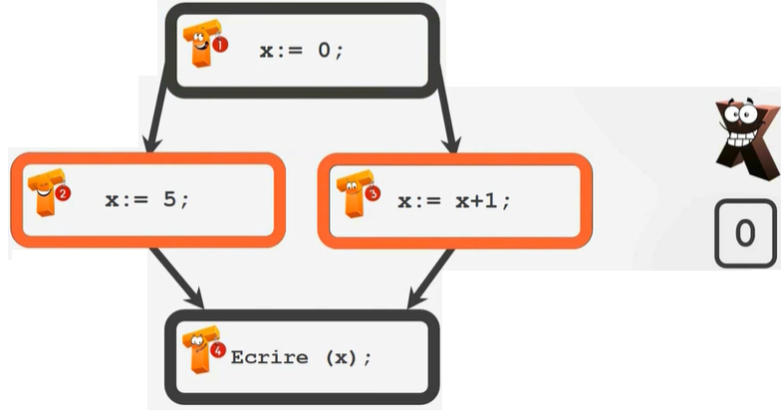
Example

Slide 33
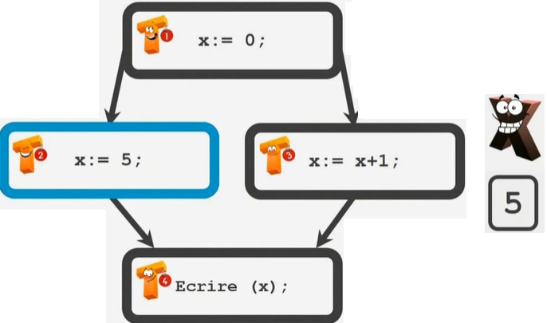

Slide 34
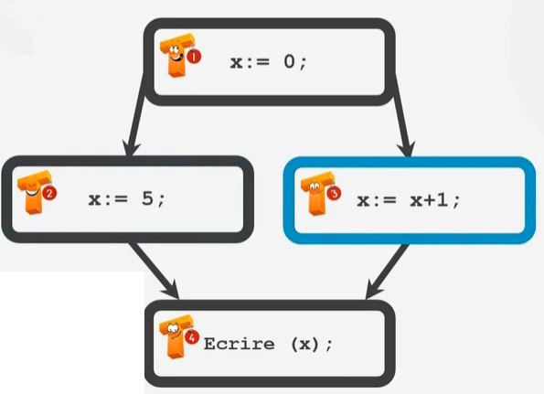

Scenario 1

Slide 35


Slide 36
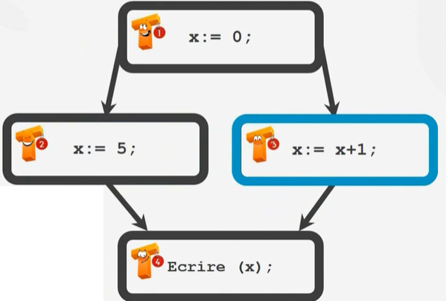

Scenario 2

Slide 37
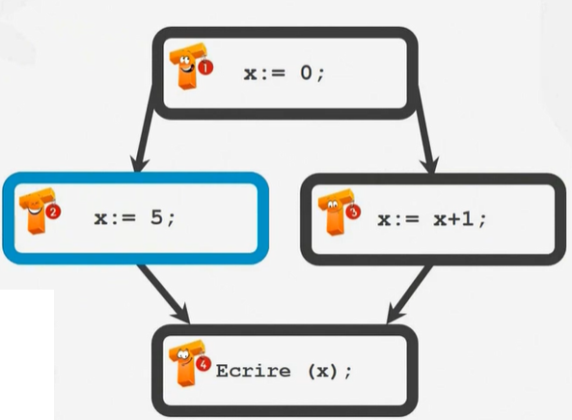


Slide 38


Slide 39
Interactions between tasks

Slide 40
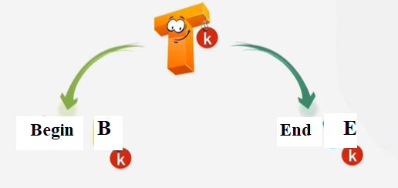
Language of a task system

Slide 41

Example

Slide 42


Example

Slide 43
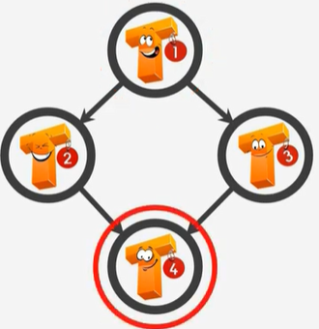

Example

Slide 44
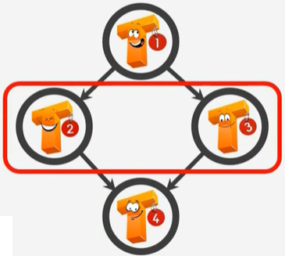

Example

Slide 45




Example
SCENARIO 1
SCENARIO 2
SCENARIO 3
SCENARIO 4

Slide 46
Language of a task system
L(S) represents the set of possible executions of a task system S. It describes the different ways tasks or processes can be scheduled and executed.
Two cases:
Non-determinism: The executions of S do not always lead to the same result
Determinism: All executions of S lead to the same result, regardless of scheduling

Slide 47
Determinism
A task system S = (E, <) is said to be determined if and only if:
All memory cells manipulated by S
Receive the same sequences of values
For each behavior w in L(S)
For all behaviors of S
The result of the system is always the same.

Slide 48
Example :
Non-determinism
Non-determinism

Slide 49
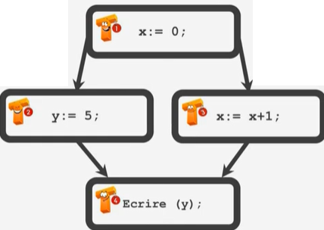


Example :
Determinism m

Slide 50

A TASK MANIPULATES A SET OF VARIABLES IN READING AND WRITING

Slide 51




Example :
Reading variables
x,m
Y := x+m
writing variables
y
Reading variables
x,y
writing variables
z

Slide 52
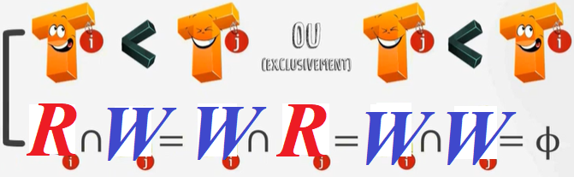
Non-Interference of Tasks
Tᵢ and Tⱼ are non-interfering if and only if Tᵢ < Tⱼ or Tⱼ < Tᵢ.
Bernstein condition
OR

Slide 53
Example :

Slide 54
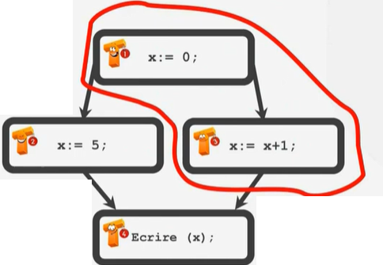
Example :
T1 and T3 are non-interfered.
T1<T3

Slide 55
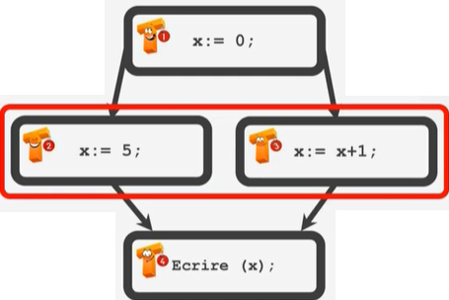


T2 and T3 are interfered.
T2 T3 and T3 T2
and

Slide 56
Exercice:
Reading variables
x,
writing variables
z
Consider a set of three tasks with the following access to variables :
T1: Reads X, writes Y
T2: Reads Y, writes Z
T3: Reads X, writes Z
Verify if T1 and T2 can be executed in parallel.
Verify if T2 and T3 satisfy Bernstein’s conditions.
Reading variables
y
writing variables
z

Slide 57
Equivalent task systems
Let two task systems S₁=(E₁,<₁) and S₂=(E₂,<₂)
S₁ and S₂ are equivalent if and only if
S₁ and S₂ are determined
S₁ and S₂ manipulate the same memory cells (variables)
For any sequence w₁ of S₁ and w₂ of S₂
The memory cells manipulated by S₁ and S₂ receive the same values

Slide 58
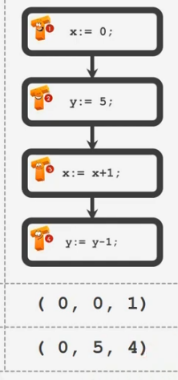
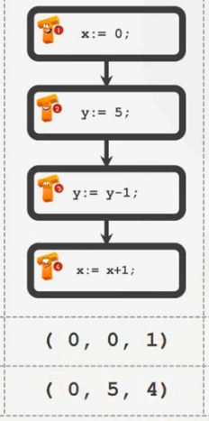


Example:
Same values
Same values

Slide 59


Maximum parallelism
Definition
Maximal parallelism systems is a determined system of tasks
The deletion of any arc (Ti,Tj) of the precedence graph G
Causes an interference between tasks Ti and Tj
Example:

Slide 60
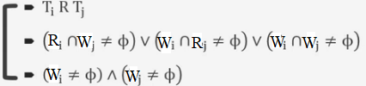
Maximum parallelism
Theorem
Let S=(E,<) be a determined system of tasks
There exists a unique maximal parallelism system S_{max} equivalent to S
S_{max}=(E, <_{max}) and to obtain <_{max} it is necessary to:
construct R the transitive closure of <
construct the relation R' from R such that Ti R' Tj if and only if
eliminate the redundancy of the relation R'
AND

Slide 61
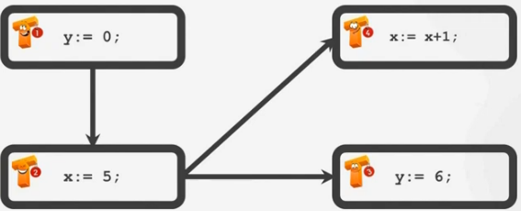
Maximum parallelism
Example:

Slide 62
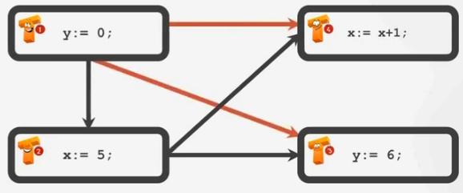
Step1: transitive closure
add transitive arcs to the graph

Slide 63
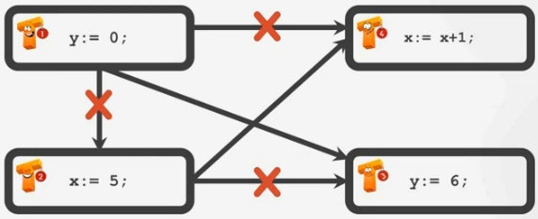
Step2: Remove arcs without which there is no inference
check the sets R and W for each task

Slide 64
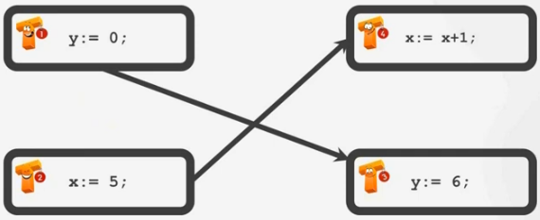
Step3: Eliminate arcs if any
some redundant arcs are no longer redundant (fast path removal)
Graph of the maximum parallelism system

Slide 65
Exercice:
T2
Suppose the following task system :
T1 : read (x)
T2 : read (y)
T3 : Z1=x+y
T4 : Z2=x*y
T5: v=z1+z2
T6 : write (v)
Draw the precedence graph (or the maximal parallelism graph) corresponding to this system after verifying Bernstein’s conditions.
T1
T4
T3
T5
T6

Slide 66
Tasks | Reading variables | writing variables | Ri ^ Wj | Wi ^ Rj | Wi ^ Wj
T1 | / | x | verified | verified | verified
T2 | / | y | verified | verified | verified
T3 | {x,y} | {z1} | verified | verified | verified
T4 | {x,y} | {z2} | verified | verified | verified
T5 | {z1,z2} | {v} | / | / | /
T6 | / | {v} | / | / | /

Slide 67

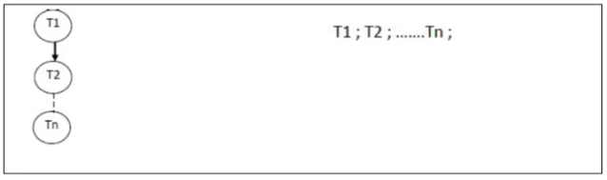
Parallelism and Parallel Languages
Parallel Languages
Sequencing Parallelization
Parbegin/Parend structure
Fork/join structure

Slide 68
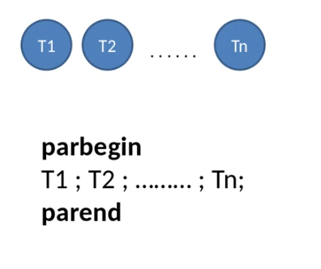
Parallelism and Parallel Languages:
Parbegin/Parend structure

Slide 69
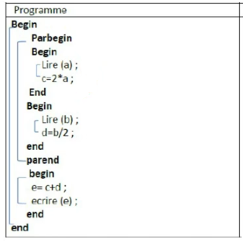
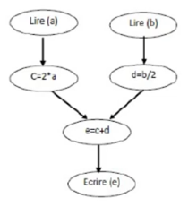
Parallelism and Parallel Languages:
Parbegin/Parend structure
Example: Give the program parbegin/ parend for the following precedence graph

Slide 70
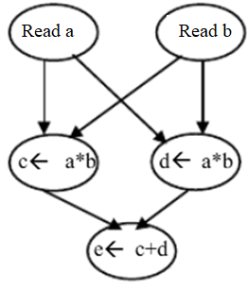
Parallelism and Parallel Languages:
Parbegin/Parend structure
Example: Give the program parbegin/ parend for the following precedence graph

Slide 71
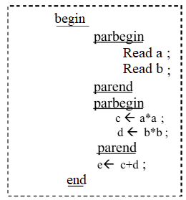
Parallelism and Parallel Languages:
Parbegin/Parend structure
Example: Give the program parbegin/ parend for the following precedence graph

Slide 72
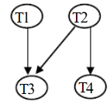
Parallelism and Parallel Languages:
Parbegin/Parend structure
Example: Can the following task graph be represented by a parallel program using parbegin parend

Slide 73
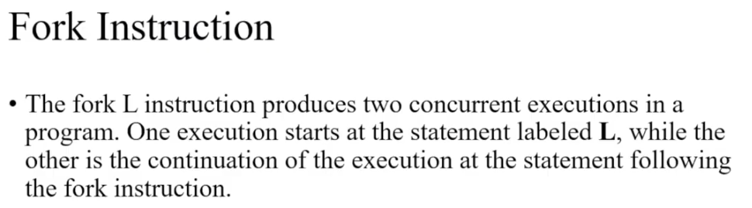
Parallelism and Parallel Languages:
Fork/join structure

Slide 74
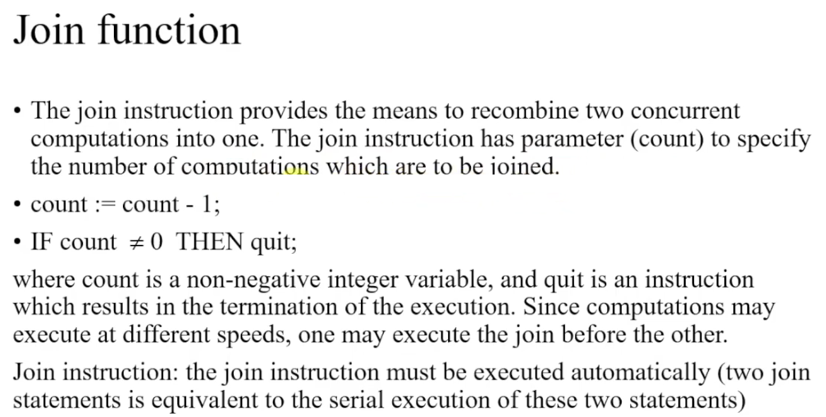
Parallelism and Parallel Languages:
Fork/join structure

Slide 75
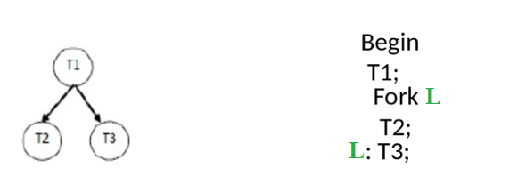

Slide 76
Parallelism and Parallel Languages:
Fork/join structure
TRY
Example:
Begin
S1
Fork L1:
S3
S4
Fork L2:
S6
L2:S5
L1:S2
End
S1
S2
S3
S4
S6
S5
S7

Slide 77
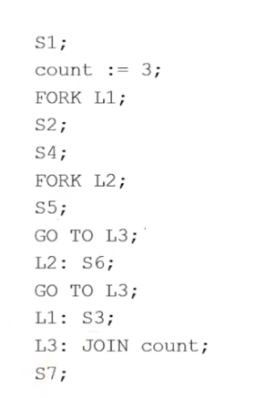
Parallelism and Parallel Languages:
Fork/join structure
S1
Example:
S2
S3
S4
S6
S5
S7

Slide 78
Annex

Slide 79
Differentiate between tasks, processes, and threads:
A task can refer to an entire process or a thread within a multithreaded process.
A process is an instance of a program running on the system.
A thread is a subdivision of a process that can execute independently.
Consider concurrent execution:
In a multitasking system, tasks can be executed sequentially or concurrently, depending on the operating system’s scheduling.

Slide 80
Difference Between Thread and Task
Criterion | Thread | Task
Definition | A thread is a unit of execution within a process. It shares memory and resources with its parent process. | A task is a specific work unit that can be executed by a thread or a process.
Management | Managed by the operating system through thread scheduling. | Managed by a task scheduler or queue.
Resources | Shares memory, files, and other resources with other threads in the same process. | Can be an independent unit executed on a separate thread or process.
Concurrency & Parallelism | Can run concurrently (with other threads of the same process) or in parallel (if multiple CPU cores are available). | Can be executed sequentially or in parallel, depending on scheduling.
Creation | Fast creation, low resource cost (e.g., pthread in C, Thread in Java). | May require more resources depending on execution needs.
Example | A web browser uses multiple threads: one for UI, one for rendering, another for downloading. | A task could be "downloading a file," which can be executed by a dedicated thread.

Slide 81
P( S( P (T3 , S(T1 , P(T6 , T5))) , T2) ,T4)
PAR Begin Parend
  Begin
  Par Begin
  T4;
  begin S1:
  par begin
  T3;
  begin S2:
  T1:
  par begin :
  T6;
  T5;
  par end
  par end
  T2;
  end S1;
  Par End
  End
T1
T4
T3
T6
T5
T2

Slide 82
P( S( P (T3 , S(T1 , P(T6 , T5))) , T2) ,T4)
Fork and Join
  Count=3;
  Begin
  T4;
  Quit;
  T1;
  fork L1:
  T6;
  Goto L2:
  L1:T5;
  GotoL2:
  L2:T2:
  Quit;
  T3;
  Goto L2;
  Join count;
  End
T4
T3
T1
T6
T5
T2

Slide 83
 | Reading variables | writing variables | Ri ^ Wj | Wi ^ Rj | Wi ^ Wj
T1 | / | x | verified | verified | verified
T2 | / | y | verified | verified | verified
T3 | {x,y} | {z1} | verified | verified | verified
T4 | {x,y} | {z2} | verified | verified | verified
T5 | {z1,z2} | {v} | / | / | /
T6 | / | {v} | / | / | /

